Slide 1
Bio211 Biostatistics and Experimental Design Winter Term 2018
Lecture 2 Describing Data
January 10, 2018

Slide 2
Outline for Today
Writing about statistics
Describing data in excel
Excel functions
Introduction to R
Download and install R

Slide 3
Writing about statistics
Methods:
Clear and concise
Reader can replicate your experiment
Results:
Descriptive writing about results ONLY, no interpretation!
Think about the best way to present the story of your results to your reader through graphs, tables, and writing.
Don’t repeat information
Notes:
Take a minute to look at your article, summarize each paragraph of the methods and results section with one sentence, and get together with a partner and talk about them
20 minutes

Slide 4
Describing Data
Mean, median, range
Variance
Standard deviation
Standard error of the mean
Notes:
Using data from human physiology lab

Slide 5
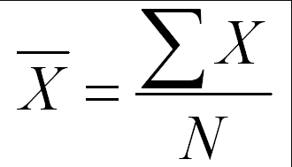
Mean
Notes:
DO THIS IN EXCEL WITH HUMAN PHYS DATA

Slide 6
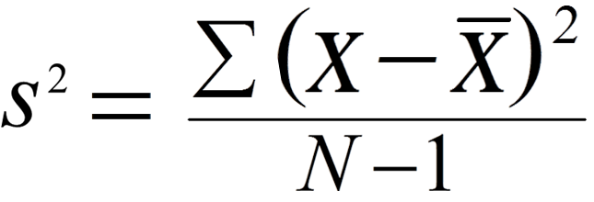
Variance
σ² =
Notes:
Sample variance (estimate of true variance ) vs population variance (true variance)
how much variation there is among individual observations

Slide 7
Standard Deviation
√
σ =
Notes:
More useful than variance because it’s in the same units as original measure
how much variation there is among individual observations. If this number is large, there is a lot of variation in observations

Slide 8
Standard Error of the Mean
√
√N
Notes:
Conventionally used to calculate length of error bars: mean +/- SEM

Slide 9
Data distributions
What is the shape of the histogram of your data?

Slide 10
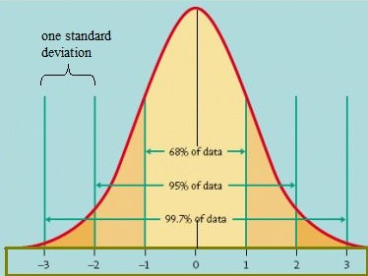
Normal distribution
Mean
Notes:
Continuous numerical data, symmetrical. Defined by the mean (top of the curve) and the standard deviation which determines spread of the curve
Mean value is at the center of the spread

Slide 11
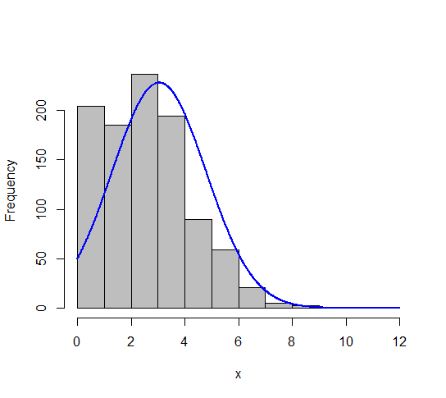
Non normal distributions Poisson distribution
Notes:
Poisson distribution
distribution describing the number of times an event occurs in a unit of time or space
No negative numbers
Mean is relatively small compared to the max

Slide 12
Intro to R
R is a language for statistical programming and graphics
Free and open source
Build around many, many R packages
Notes:
R packages are the fuel that drive the growth and popularity of R. R packages are bundles of code, data, documentation, and tests that are easy to share with others. Before you can use a package, you will first have to install it. Some packages, like the base package, are automatically installed when you install R. Other packages, like for example the ggplot2 package, won’t come with the bundled R installation but need to be installed.

Slide 13
Download and install R studio
We will be using R Studo
Integrated development environment (IDE) for R
Includes console, syntax-highlighting editor that supports direct code execution, tools for plotting, history, debugging and workspace management
https://www.rstudio.com/

Slide 14
Getting started with R
http://tryr.codeschool.com/levels/1/challenges/4
Notes:
Let them do this I class

Slide 15
Working directory & importing data
Follow along in Rstudio!
Notes:
Read in data from human physiology lab!

Slide 16
Lab this afternoon
Lab will be split into 2 time sections
Form 6 groups
Groups 1, 2, and 3 will attend lab from 1:00 – 2:00
Groups 4, 5, and 6 will attend lab from 2:00 – 3:00

Slide 17
Summary
Sampling board lab this afternoon
R studio downloaded and installed by Friday morning
Assignment 2 Sampling board worksheet by Friday morning. I will give you this handout at the start of lab

